Slide 1
Basic Electronics Engineering
3CSE3 & 3CSE4
No. of modules : 5
Sessions Planned: 68
Credit: 4
No of students registered: 63 (3CSE3)

Slide 2
Module 1: Semiconductor Diodes & Diode Circuits
13 Hr lectures + 6 Hr Lab

Slide 3
Prerequisites
To understand this presentation, you should have the following prior knowledge:
Draw the structure of an atom, including electrons, protons, and neutrons.
Define resistance and conductance.
Label an electronic schematic, indicating current flow.
Define Ohm’s and Kirchhoff’s laws.
Describe the characteristics of DC and AC (sine wave) voltages.

Slide 4
Student Learning Outcomes
Upon completion of viewing this presentation, you should be able to:
Define conductor, insulator and semiconductor, and state the resistance or conductance of each.
Name the current carriers in N and P-type material.
Analyze the characteristics of PN junction diode and zener diode.
Application of diodes as clippers and clampers.

Slide 5
Semiconductor Material: Ge, Si and GaAs
Semiconductor Material type
Single Crystal eg. Si and Ge
Compound eg. GaAs, CdS, GaN and GaAsP
Most used

Slide 6
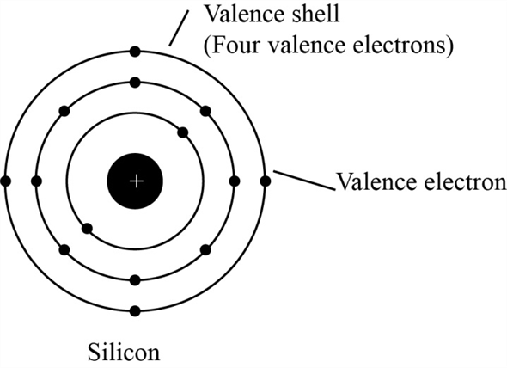
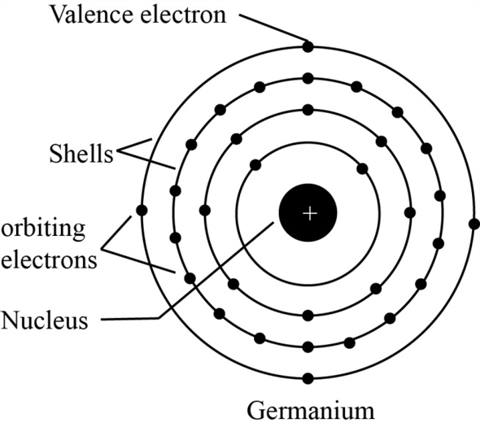
Si and Ge atomic structure
Si atomic no is 14 (2,8,4)
Ge atomic no is 32 (2,8,18,4)

Slide 7
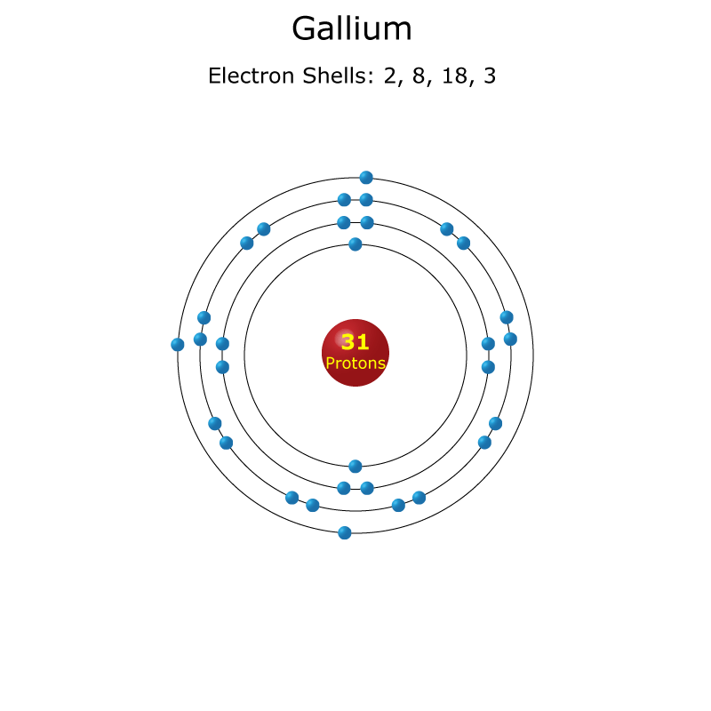
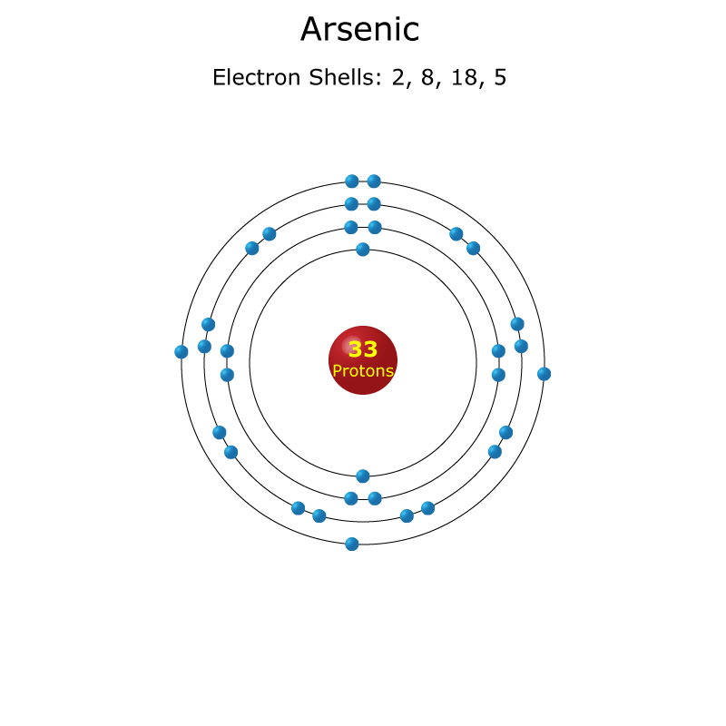
GaAs

Slide 8
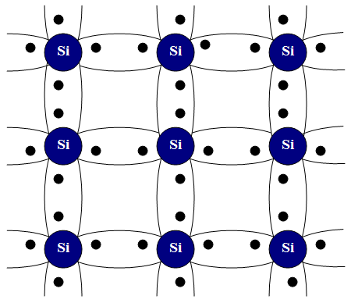
Covalent bonding of Si and GaAs
Si has four valence electrons.
Therefore, it can form covalent bonds with
four of its neighbors.
When temperature goes up,
electrons in the covalent bond can
become free.

Slide 9
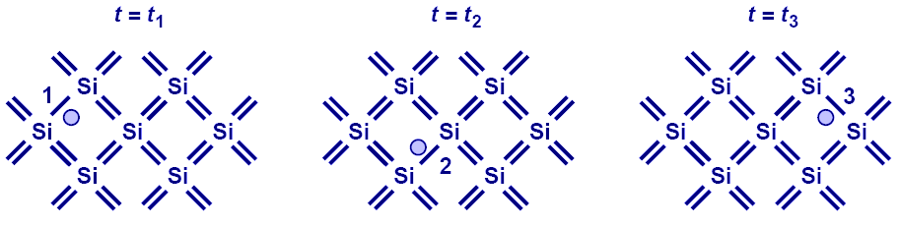
Electron-hole pair interaction
With free electrons breaking off covalent bonds, holes are generated.
Holes can be filled by absorbing other free electrons, so effectively there is a flow of charge carriers.

Slide 10
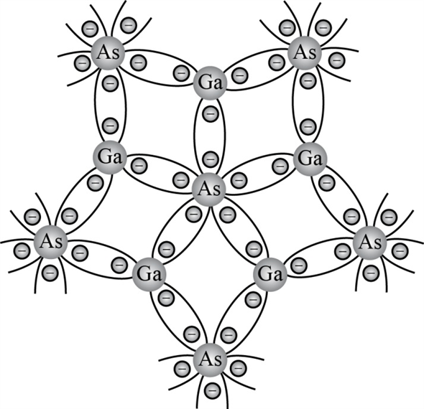
Covalent bonding of GaAs
Ga has valancy of 3
As has valancy of 5

Slide 11
Intrinsic carriers (300K)
Semiconductor | Intrinsic Carriers ( per cubic cm)
GaAs | 1.7 x 10^6
Si | 1.5 x 10^10
Ge | 2.5 x 10^13
Intrinsic : very low impurity Semiconductor - As pure as can be possible.
Free electrons in a material due only to external causes are referred as intrinsic carriers.
Relative Mobility
Semiconductor | Mobility (cm^2/V.s)
Si | 1500
Ge | 3900
GaAs | 8500

Slide 12
Temperature effect on SM:
Semiconductors have negative temperature coefficient ( conductivity increases with application of heat)
Conductors have positive temperature coefficient ( conductivity decreases with application of heat)

Slide 13
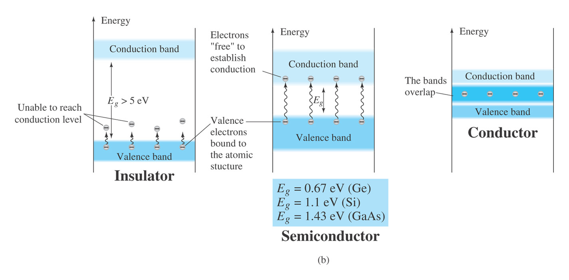
Different Types of Solids
Fermi level
Fermi level falls between bands, with a large band gap. SiO2: 9 eV.
>5eV
Fermi level falls between bands, with a small band gap.Si: 1.11 eV, Ge:0.67 eV, GaAs: 1.43
Fermi level falls inside the energy band. Easy for electrons to move around

Slide 14
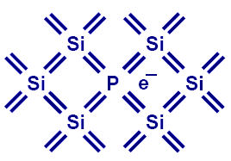
Extrinsic Materials: N- type
Free Electron
Pure Si can be doped with other elements to change its electrical properties.
For example, if Si is doped with P (phosphorous), then it has more electrons, or becomes type N (electron).
Diffused impurities with 5 valence electrons are called donor atoms eg. Antimony, arsenic , phosphorous.

Slide 15
At room temperature in an intrinsic Si, there is 1 free electron for every 10^12 atoms.
If dosage level is 1 in 10 million (10^7), the ratio 10^12/ 10^7 = 10^5 indicates that the carrier concentration has increased by ratio of 100000:1

Slide 16
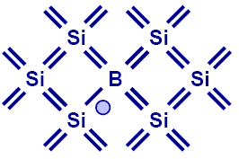
P-type semiconductor
If Si is doped with B (boron), then it has more holes, or becomes type P.
Boron, gallium, indium can be used.
The diffused impurity with 3 valance electrons are called acceptor atoms.

Slide 17
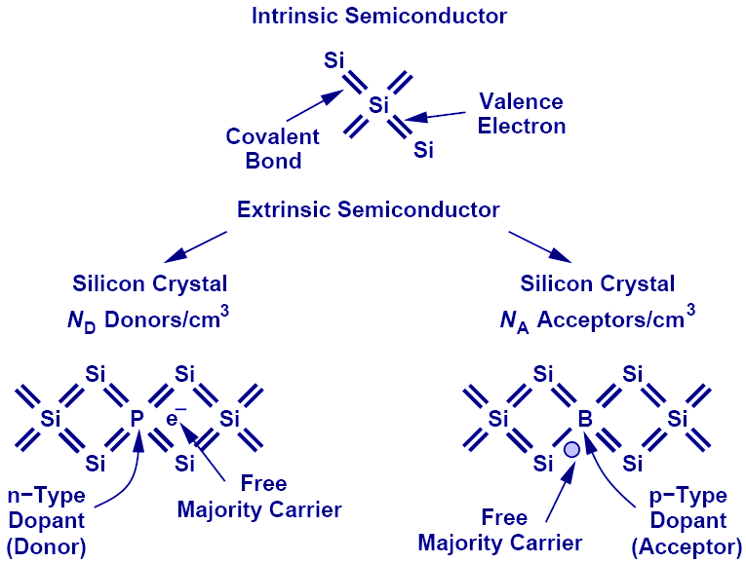
Summary of charge carriers

Slide 18
Electron-Hole density
Majority Carriers :
Minority Carriers :
Majority Carriers :
Minority Carriers :
The product of electron and hole densities is ALWAYS equal to the square of intrinsic electron density regardless of doping levels.

Slide 19
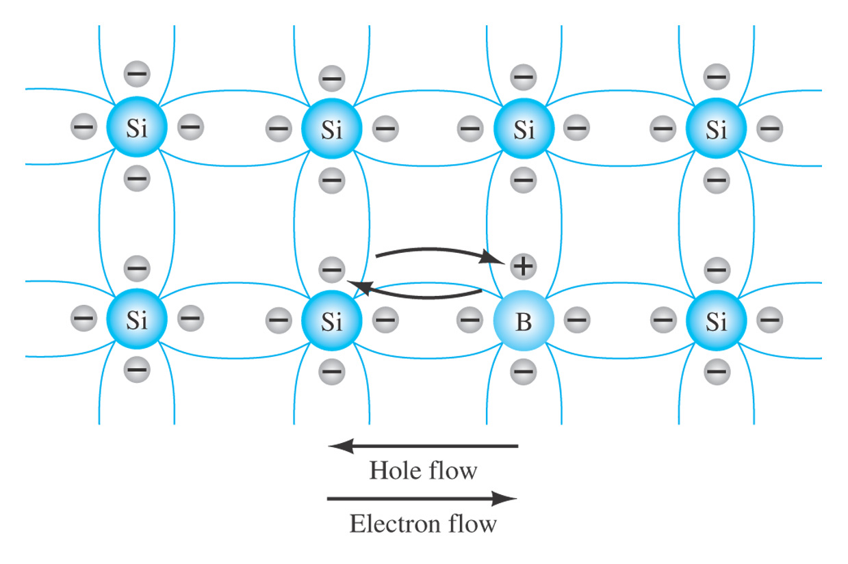
Electron versus hole flow
The valence electron acquires sufficient kinetic energy to break its covalent bond and fills the void created by hole
When the electron move to fill the hole therefore a transfer of holes to the left and electrons to the right
This flow is known as conventional flow.

Slide 20
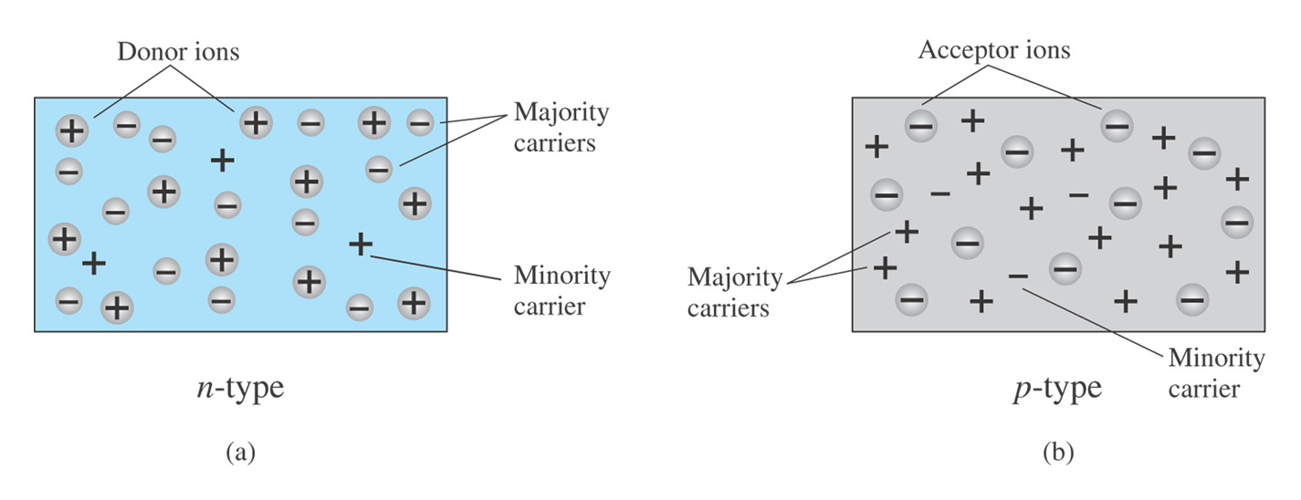
Majority and Minority Carriers
N-type material, the electron is called majority carrier and hole the minority carrier
P-type material, the hole is called majority carrier and electron the minority carrier.

Slide 21
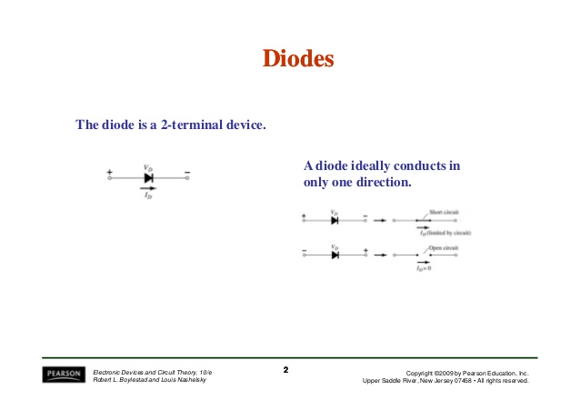
Semiconductor Diode
n junction with no external bias. (a) An internal distribution of charge; (b) a diode symbol, with the
n junction with no external bias. (a) An internal distribution of charge; (b) a diode symbol, with the
n junction with no external bias. (a) An internal distribution of charge; (b) a diode symbol, with the
Fig.
Fig.
Fig.
1
1
1
.
.
.
12
12
12
A p
A p
A p
–
–
–
Fig.
Fig.
Fig.
Fig.
Fig.
Fig.
1
1
1
1
1
1
.
.
.
.
.
.
13
14
13
14
13
14
Reverse
Forward
Reverse
Forward
Reverse
Forward
-
-
-
-
-
-
biased p
biased p
biased p
biased p
biased p
biased p
–
–
–
–
–
–
n junction. (a) Internal distribution of charge under reverse
n junction. (a) Internal distribution of charge under reverse
n junction. (a) Internal distribution of charge under reverse
n junction. (a) Internal distribution of charge under forward
n junction. (a) Internal distribution of charge under forward
n junction. (a) Internal distribution of charge under forward
-
bias conditions; (b) reverse
-
-
bias conditions; (b) forward
-
-
bias conditions; (b) reverse
-
-
bias conditions; (b) forward
-
-
bias conditions; (b) reverse
-
-
bias conditions; (b) forward
-
e
e
e
x
x
x
Fig.
Fig.
Fig.
defined polarity and the current direction; (c) demonstration that the net carrier flow is zero at the external terminal of
Fig.
Fig.
Fig.
Fig.
Fig.
Fig.
Fig.
defined polarity and the current direction; (c) demonstration that the net carrier flow is zero at the external terminal of
Fig.
Fig.
Fig.
Fig.
Fig.
Fig.
Fig.
defined polarity and the current direction; (c) demonstration that the net carrier flow is zero at the external terminal of
Fig.
Fig.
Fig.
Fig.
-
-
-
1
1
1
1
1
1
1
1
1
1
1
1
1
1
1
1
1
1
1
1
1
.
.
.
.
.
.
.
.
.
.
.
.
.
.
.
.
.
.
.
.
.
9
10
11
15
16
17
18
9
10
11
15
16
17
18
9
10
11
15
16
17
18
Boron impurity in p
Boron impurity in p
Boron impurity in p
Electron versus hole flow.
(a) n
Silicon semiconductor diode characteristics.
Plot of
Zener region.
Comparison of Ge, Si, and GaAs diodes.
Electron versus hole flow.
(a) n
Silicon semiconductor diode characteristics.
Plot of
Zener region.
Comparison of Ge, Si, and GaAs diodes.
Electron versus hole flow.
(a) n
Silicon semiconductor diode characteristics.
Plot of
Zener region.
Comparison of Ge, Si, and GaAs diodes.
-
-
-
type material; (b) p
type material; (b) p
type material; (b) p
.
.
.
-
-
-
type material.
type material.
type material.
type material.
type material.
type material.
bias polarity and direction of reverse saturation current.
bias polarity and direction of resulting current.
bias polarity and direction of reverse saturation current.
bias polarity and direction of resulting current.
bias polarity and direction of reverse saturation current.
bias polarity and direction of resulting current.
V
V
V
V
V
V
the device when
the device when
the device when
=
=
=
0
0
0
.
.
.
D
D
D
Robert L. Boylestad
Electronic Devices and Circuit Theory,
Robert L. Boylestad
Electronic Devices and Circuit Theory,
Robert L. Boylestad
Electronic Devices and Circuit Theory,
Robert L. Boylestad
Electronic Devices and Circuit Theory,
Robert L. Boylestad
Electronic Devices and Circuit Theory,
Robert L. Boylestad
Electronic Devices and Circuit Theory,
Robert L. Boylestad
Electronic Devices and Circuit Theory,
Robert L. Boylestad
Electronic Devices and Circuit Theory,
Robert L. Boylestad
Electronic Devices and Circuit Theory,
Robert L. Boylestad
Electronic Devices and Circuit Theory,
Robert L. Boylestad
Electronic Devices and Circuit Theory,
Robert L. Boylestad
Electronic Devices and Circuit Theory,
Robert L. Boylestad
Electronic Devices and Circuit Theory,
Robert L. Boylestad
Electronic Devices and Circuit Theory,
Robert L. Boylestad
Electronic Devices and Circuit Theory,
Robert L. Boylestad
Electronic Devices and Circuit Theory,
Robert L. Boylestad
Electronic Devices and Circuit Theory,
Robert L. Boylestad
Electronic Devices and Circuit Theory,
Robert L. Boylestad
Electronic Devices and Circuit Theory,
Robert L. Boylestad
Electronic Devices and Circuit Theory,
Robert L. Boylestad
Electronic Devices and Circuit Theory,
Robert L. Boylestad
Electronic Devices and Circuit Theory,
Robert L. Boylestad
Electronic Devices and Circuit Theory,
Robert L. Boylestad
Electronic Devices and Circuit Theory,
Robert L. Boylestad
Electronic Devices and Circuit Theory,
Robert L. Boylestad
Electronic Devices and Circuit Theory,
Robert L. Boylestad
Electronic Devices and Circuit Theory,
Robert L. Boylestad
Electronic Devices and Circuit Theory,
Robert L. Boylestad
Electronic Devices and Circuit Theory,
Robert L. Boylestad
Electronic Devices and Circuit Theory,
Upper Saddle River, New Jersey
Upper Saddle River, New Jersey
Upper Saddle River, New Jersey
Upper Saddle River, New Jersey
Upper Saddle River, New Jersey
Upper Saddle River, New Jersey
Upper Saddle River, New Jersey
Upper Saddle River, New Jersey
Upper Saddle River, New Jersey
Upper Saddle River, New Jersey
Upper Saddle River, New Jersey
Upper Saddle River, New Jersey
Upper Saddle River, New Jersey
Upper Saddle River, New Jersey
Upper Saddle River, New Jersey
Upper Saddle River, New Jersey
Upper Saddle River, New Jersey
Upper Saddle River, New Jersey
Upper Saddle River, New Jersey
Upper Saddle River, New Jersey
Upper Saddle River, New Jersey
Upper Saddle River, New Jersey
Upper Saddle River, New Jersey
Upper Saddle River, New Jersey
Upper Saddle River, New Jersey
Upper Saddle River, New Jersey
Upper Saddle River, New Jersey
Upper Saddle River, New Jersey
Upper Saddle River, New Jersey
Upper Saddle River, New Jersey
9
9
9
9
9
9
9
9
9
9
9
9
9
9
9
9
9
9
9
9
9
9
9
9
9
9
9
9
9
9
e
e
e
e
e
e
e
e
e
e
e
e
e
e
e
e
e
e
e
e
e
e
e
e
e
e
e
e
e
e
Copyright ©
2006
by Pearson Education, Inc.
07458
All rights reserved.
Copyright ©
2006
by Pearson Education, Inc.
07458
All rights reserved.
Copyright ©
2006
by Pearson Education, Inc.
07458
All rights reserved.
Copyright ©
2006
by Pearson Education, Inc.
07458
All rights reserved.
Copyright ©
2006
by Pearson Education, Inc.
07458
All rights reserved.
Copyright ©
2006
by Pearson Education, Inc.
07458
All rights reserved.
Copyright ©
2006
by Pearson Education, Inc.
07458
All rights reserved.
Copyright ©
2006
by Pearson Education, Inc.
07458
All rights reserved.
Copyright ©
2006
by Pearson Education, Inc.
07458
All rights reserved.
Copyright ©
2006
by Pearson Education, Inc.
07458
All rights reserved.
Copyright ©
2006
by Pearson Education, Inc.
07458
All rights reserved.
Copyright ©
2006
by Pearson Education, Inc.
07458
All rights reserved.
Copyright ©
2006
by Pearson Education, Inc.
07458
All rights reserved.
Copyright ©
2006
by Pearson Education, Inc.
07458
All rights reserved.
Copyright ©
2006
by Pearson Education, Inc.
07458
All rights reserved.
Copyright ©
2006
by Pearson Education, Inc.
07458
All rights reserved.
Copyright ©
2006
by Pearson Education, Inc.
07458
All rights reserved.
Copyright ©
2006
by Pearson Education, Inc.
07458
All rights reserved.
Copyright ©
2006
by Pearson Education, Inc.
07458
All rights reserved.
Copyright ©
2006
by Pearson Education, Inc.
07458
All rights reserved.
Copyright ©
2006
by Pearson Education, Inc.
07458
All rights reserved.
Copyright ©
2006
by Pearson Education, Inc.
07458
All rights reserved.
Copyright ©
2006
by Pearson Education, Inc.
07458
All rights reserved.
Copyright ©
2006
by Pearson Education, Inc.
07458
All rights reserved.
Copyright ©
2006
by Pearson Education, Inc.
07458
All rights reserved.
Copyright ©
2006
by Pearson Education, Inc.
07458
All rights reserved.
Copyright ©
2006
by Pearson Education, Inc.
07458
All rights reserved.
Copyright ©
2006
by Pearson Education, Inc.
07458
All rights reserved.
Copyright ©
2006
by Pearson Education, Inc.
07458
All rights reserved.
Copyright ©
2006
by Pearson Education, Inc.
07458
All rights reserved.

Slide 22
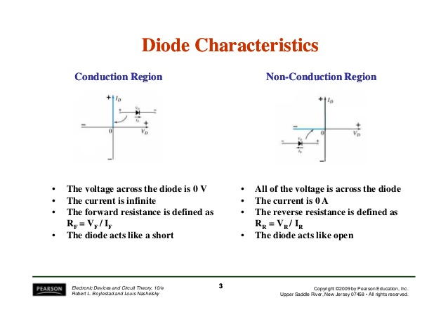

Slide 23
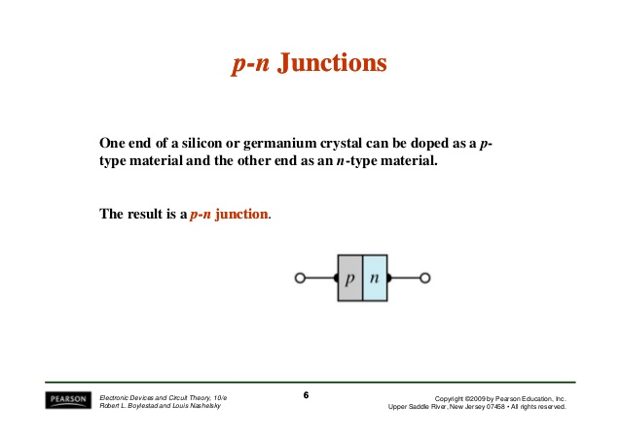

Slide 24
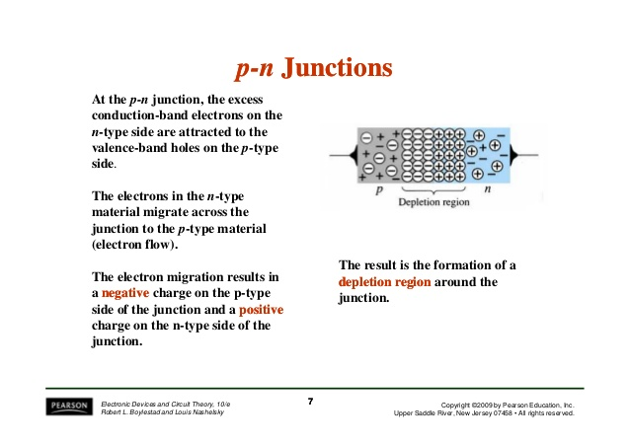

Slide 25
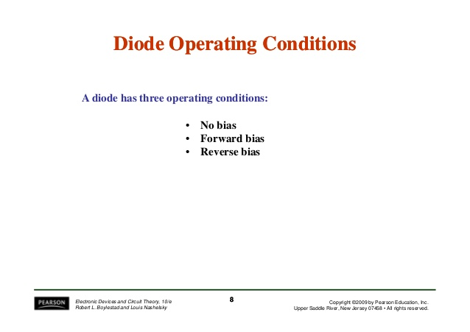

Slide 26
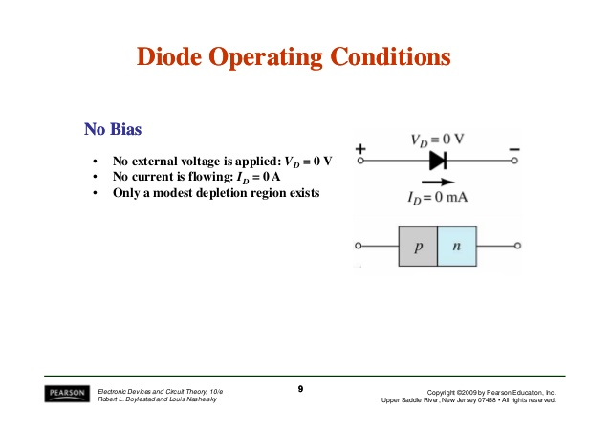

Slide 27
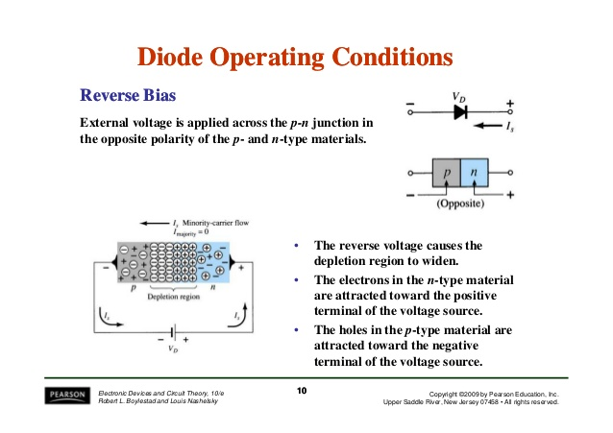

Slide 28
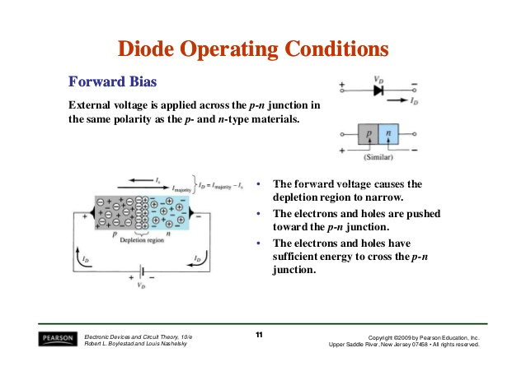

Slide 29
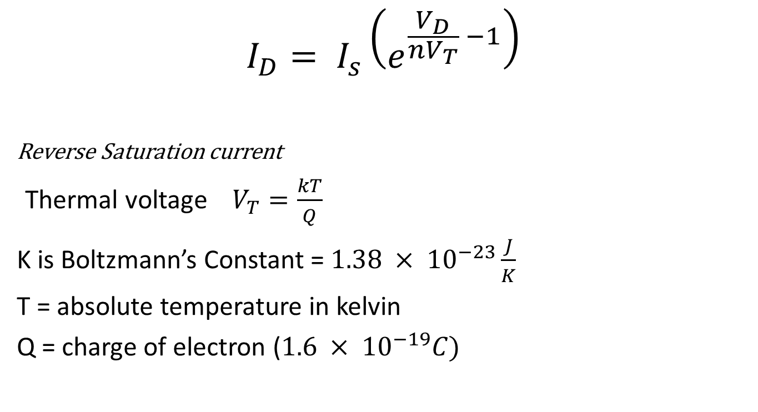
Shockley’s Equation
$$I_{D}= I_{s}\left(e^{\frac{V_{D}}{nV_{T}} −1}\right)$$
Reverse Saturation current
Thermal voltage $V_{T}=\frac{kT}{Q}$
K is Boltzmann’s Constant = $1.38 × {10}^{−23}\frac{J}{K}$
T = absolute temperature in kelvin
Q = charge of electron ($1.6 × {10}^{−19}C)$
Applied Forward Bias Voltage

Slide 30
???
The arrow direction in the diode symbol indicates
a. Direction of electron flow.
b. Direction of hole flow (Direction of conventional current)
c. Opposite to the direction of hole flow
d. None of the above
Ans : B

Slide 31
When the diode is forward biased, it is equivalent to
a. An off switch
b. An On switch
c. A high resistance
d. None of the above
Ans : B

Slide 32
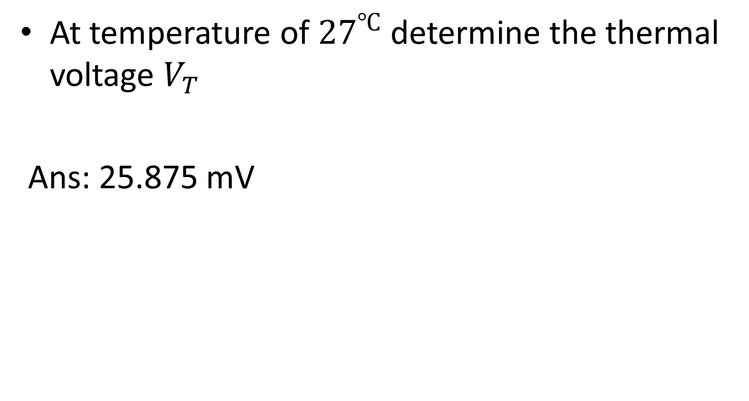
???
At temperature of ${27}^{℃}$ determine the thermal voltage $V_{T}$
Ans: 25.875 mV

Slide 33
Under normal reverse bias voltage applied to diode, the reverse current in Si diode
a. 100 mA
b. order of μA
c. 1000 μA
d. None of these
Ans: B

Slide 34
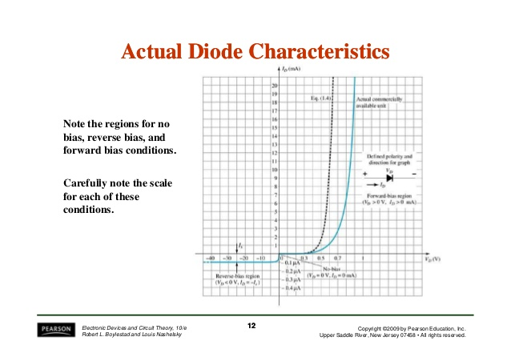

Slide 35
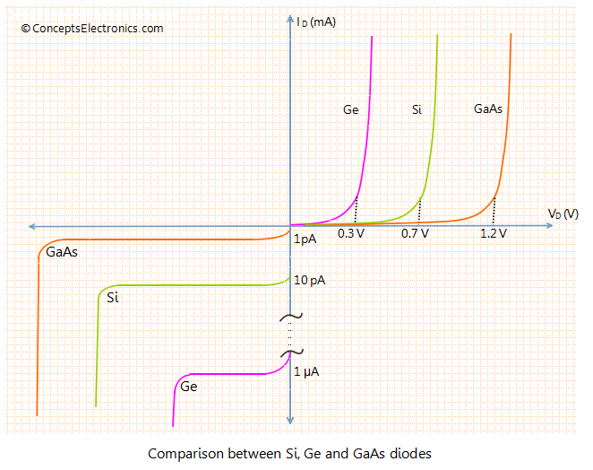
Knee voltage…

Slide 36


Slide 37
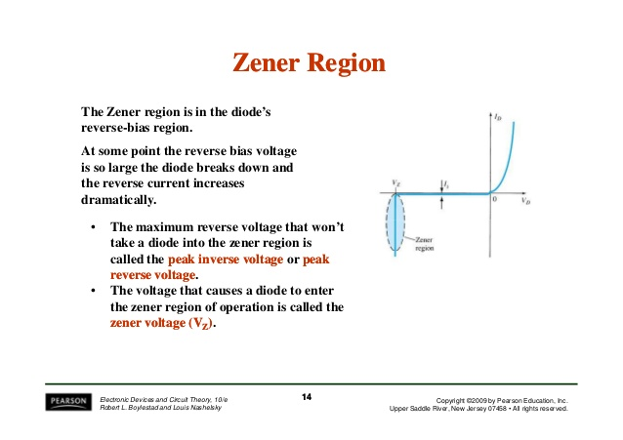

Slide 38
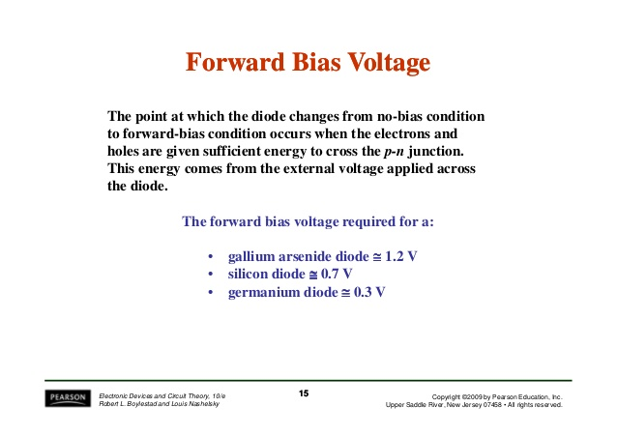

Slide 39
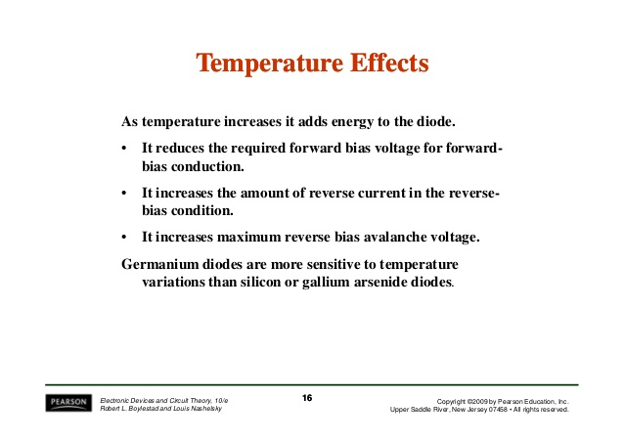

Slide 40
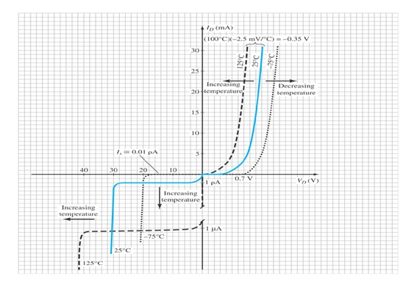
In the reverse bias region the reverse saturation current of a silicon diode doubles for every 10 degee C rise in temperature.

Slide 41
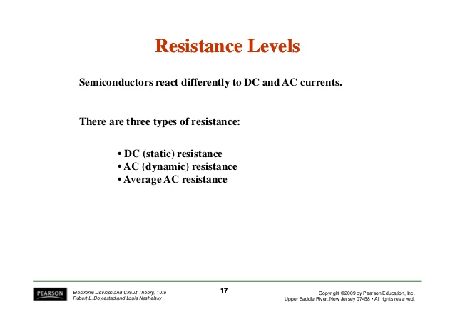

Slide 42
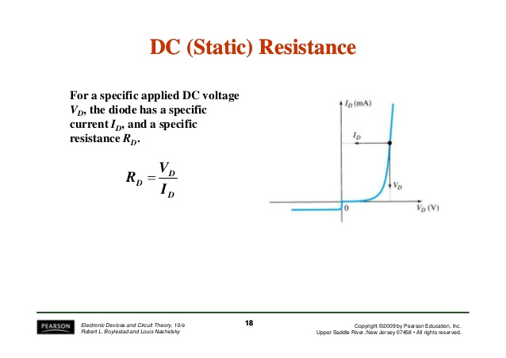

Slide 43
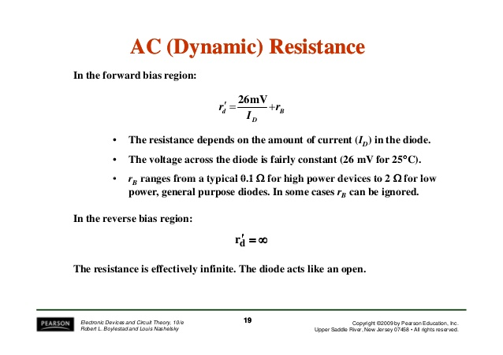

Slide 44
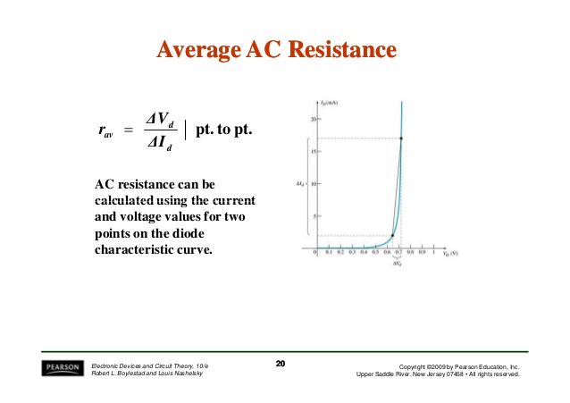

Slide 45
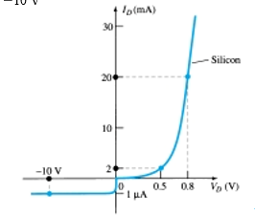
???
Determine the DC resistance levels for diode at
Diode current= 2mA and 20mA
Diode voltage= 10V

Slide 46
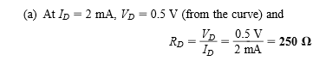
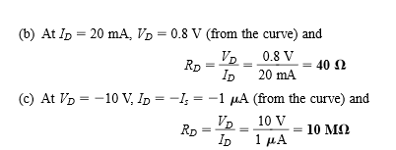
Ans

Slide 47
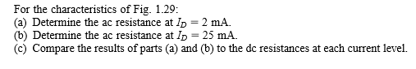
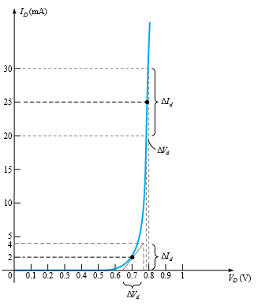
???

Slide 48
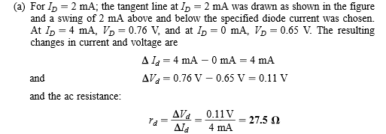
Ans

Slide 49
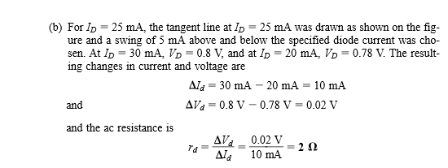
Ans

Slide 50
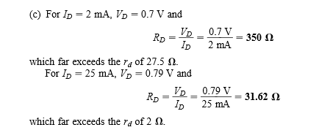

Slide 51
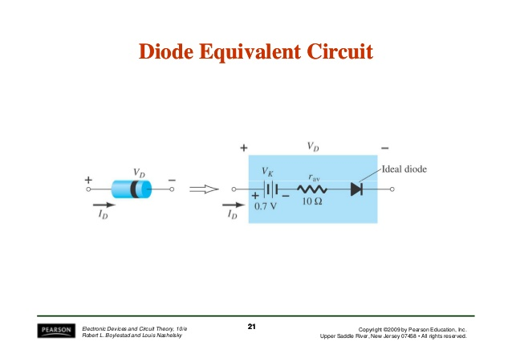

Slide 52
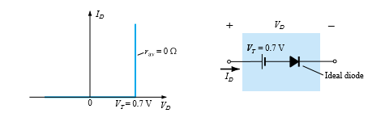
Simplified equivalent circuit

Slide 53
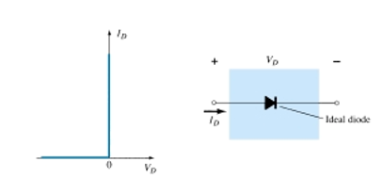
Ideal Equivalent circuit

Slide 54
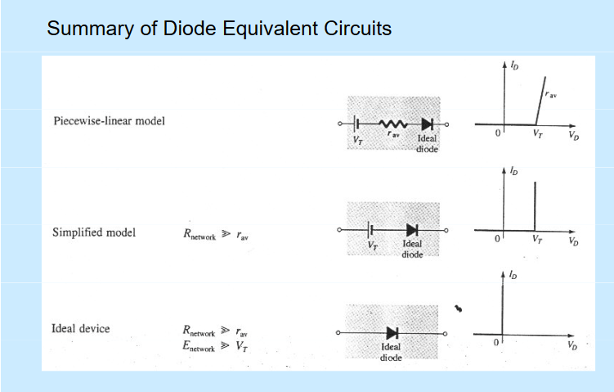

Slide 55
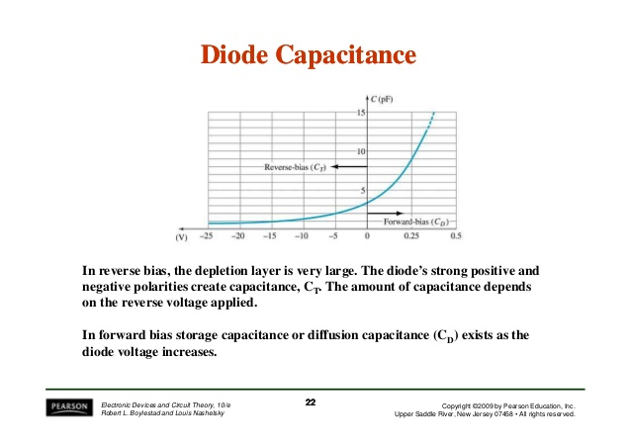
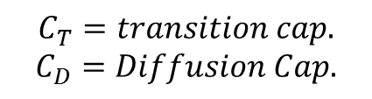
$$C_{T}=transition cap.$$
$$C_{D}=Diffusion Cap.$$

Slide 56
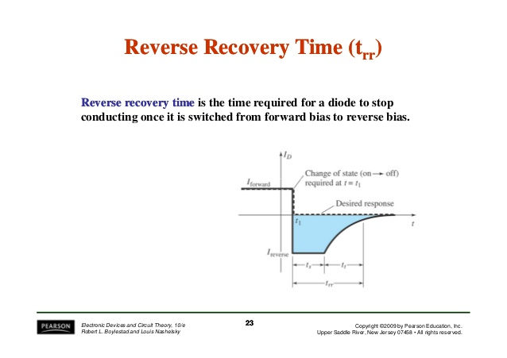
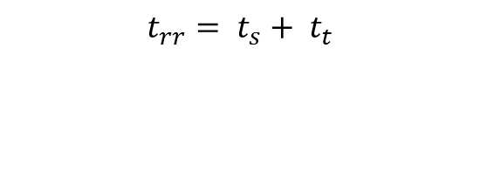
$$t_{rr}= t_{s}+ t_{t}$$
Storage Time & Transition Time

Slide 57
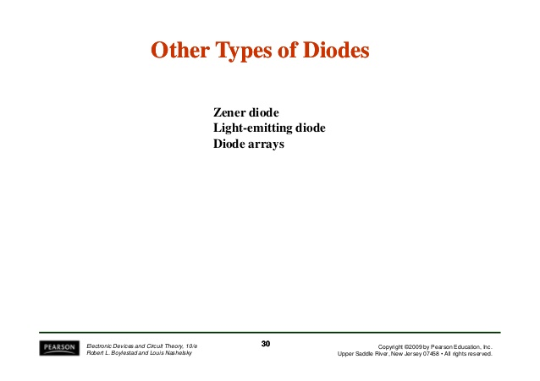

Slide 58


Slide 59

Zener Characteristics

Slide 60
Zener effect and Zener diode
When a Zener diode is reverse-biased, it acts at the breakdown region, when it is forward biased, it acts like a normal PN junction diode
Avalanche Effect
Gain kinetic energy – hit another atom –produce electron and hole pair

Slide 61


Voltage Regulator using Zener Diode
The remainder of V_{PS} drops across R_{i}
2. The load resistor sees a constant voltage regardless of the current
1. The zener diode holds the voltage constant regardless of the current

Slide 62




Zener Diode as Voltage Regulator
Three Cases:
$V_{i} and R$ Fixed
Fixed $V_{i} and Variable R_{L}.$
Fixed $R_{L} and variable V_{i}$.
Case 1: Determine the state of zener diode by removing it from the network and calculating the voltage across the resulting open circuit.

Slide 63




If V > Vz zener diode is on, the the appropriate equivalent model can be substituted.
If V < Vz zener diode is off, the open circuit model can be substituted
2. If zener diode is ON

Slide 64

Question:

Slide 65



Slide 66



Slide 67



Slide 68




Case 2:
For fixed value of load resistance the input voltage must be sufficiently large to turn the zener diode on.
The mini. Turn on voltage is $V_{i}= V_{imini}$ is determined by
And $V_{i mini}= \frac{\left(R_{L}+R\right)V_{Z}}{R_{L}}$

Slide 69


Slide 70


Slide 71


Slide 72


Slide 73



Slide 74

Case 3: Fixed load resistance and variable input supply

Slide 75


Slide 76


Slide 77


Slide 78

LED…….What is an LED?
Light-emitting diode
Semiconductor
Has polarity

Slide 79


Inside a Light Emitting Diode
Transparent Plastic Case
Terminal Pins
Diode
Wavelength $λ=\frac{c}{f}$

Slide 80

LED: How It Works
When current flows across a diode
Negative electrons move one way and positive holes move the other way

Slide 81

LED: How It Works
The holes exist at a lower energy level than the free electrons
Therefore when a free electrons falls it losses energy

Slide 82

LED: How It Works
This energy is emitted in a form of a photon, which causes light
The color of the light is determined by the fall of the electron and hence energy level of the photon

Slide 83

Kinds of LEDs

Slide 84

How to Connect a LED:
Requires 1.5~2.5V and 10 mA
To prevent overloading, use resistor 470 Ω

Slide 85

How to Connect a LED:

Slide 86


Connect LED to BS2
LED is on when P0 is high
LED is on when P1 is low

Slide 87


Connect Multiple LEDs to BS2
8 LEDs are connected to BS2 each I/O pin (P0-P7) is allowed to sink 6.25mA

Slide 88


Case Study: Blinking LED

Slide 89
Case Study: Blinking LED
Pbasic program to make an LED blink
output 0
Main:
low 0
pause 1000
high 0
pause 1000
goto Main
Make pin0 an output
Loop begins here
Turn LED on
Pause for 1 sec
Turn LED off
Pause for 1 sec
Go back to beginning of loop

Slide 90
Experiments
Flash an LED
Single LED
Multiple LEDs
Traffic Light by use of LEDs

Slide 91
Diode as a Rectifier
Half wave rectifier
Full wave Rectifier- center Tap & Bridge Rectifier

Slide 92

Single-Phase Half-Wave Rectifier

Slide 93

Waveforms

Slide 94
Single-Phase Half-Wave Rectifier

Slide 95
Performance Parameters
Average value of the output voltage, V_{dc}
Average value of the output current, I_{dc}
Output dc power, P_{dc}
P_{dc} = V_{dc}I_{dc}
rms value of the output voltage, V_{rms}
Output ac power, P_{ac}
P_{ac} = V_{rms}I_{rms}

Slide 96
Performance Parameters (continued)
Efficiency, η
η = P_{dc}/P_{ac}
Effective (rms) value of the ac component of the output voltage, V_{ac}
V_{ac} = √V_{rms}² – V_{dc}²
Form factor, FF
FF = V_{rms}/V_{dc}
Ripple factor, RF
RF = V_{ac}/V_{dc}

Slide 97
Performance Parameters (continued)
Alternate form for ripple factor
Transformer utilization factor, TUF
TUF = P_{dc}/V_{s}I_{s}
V_{s}, I_{s} are rms voltage and current of the transformer secondary

Slide 98

Input Voltage and Current

Slide 99
Performance Parameters (continued)
Displacement angle, Φ
Displacement Factor, DF
DF = cos(Φ)
Harmonic Factor, HF

Slide 100
Performance Parameters (continued)
Power Factor, PF

Slide 101
Performance Parameters (continued)
Crest Factor, CF

Slide 102
Example 3.1
Determine η, FF, RF, TUF, PIV of the diode, CF of the input current, input PF.

Slide 103
Determine the Average Voltage, V_{dc}

Slide 105
Determine the rms Voltage, V_{rms}

Slide 106
Determine P_{dc}, P_{ac}, and η

Slide 107
Determine FF and RF

Slide 108
Determine the TUF

Slide 109
Determine the PIV
PIV is the maximum (peak) voltage that appears across the diode when reverse biased. Here, PIV = V_{m}.
-
-
+
PIV
+

Slide 110
Determine CF

Slide 111
Determine PF

Slide 112
Summary – Half-Wave Rectifier
RF=121% High
Efficiency = 40.5 Low
TUF = 0.286 Low
1/TUF = 3.496
transformer must be 3.496 times larger than when using a pure ac voltage source

Slide 113

Half-Wave Rectifier with R-L Load

Slide 114

Waveforms of Current and Voltage
Conduction period of D₁ extends beyond ωt = π

Slide 115
Average Output Voltage
Increase average voltage and current by making σ = 0

Slide 116

Waveforms with D_{m} installed

Slide 117

Application as a Battery Charger
Diode conducts for v_{s} > E, starting when V_{m}sinα = E

Slide 118

Waveforms for the Battery Charger
Diode turns off when v_{s} < E (at β = π – α)
Charging current i_{o} = (v_{s} – E)/R
i_{o} = (V_{m}sinωt – E)/R for α < ωt < β

Slide 119
FULL WAVE RECTIFIER
Center-Tapped
Bridge

Slide 120

Single-Phase Full-Wave Rectifier
Center-Tapped Transformer

Slide 121

Waveforms for the Full-Wave Rectifier

Slide 122
Single-Phase Full-Wave Rectifier
PIV = 2V_{m}

Slide 123

Full-Wave Bridge Rectifier

Slide 124

Waveforms for the Full-Wave Bridge

Slide 125
Full-Wave Bridge with Waveforms
Conduction pattern
D₁ – D₂ D₃ – D₄
PIV = V_{m}

Slide 126


Full-Wave Rectification – circuit with center-tapped transformer
Positive cycle, D2 off, D1 conducts;
Vo – Vs + Vγ = 0
Vo = Vs - Vγ
Negative cycle, D1 off, D2 conducts;
Vo – Vs + Vγ = 0
Vo = Vs - Vγ
Since a rectified output voltage occurs during both positive and negative cycles of the input signal, this circuit is called a full-wave rectifier.
Also notice that the polarity of the output voltage for both cycles is the same

Slide 127

Vs = Vpsin ωt
V_{p}
Vγ
-Vγ
Notice again that the peak voltage of Vo is lower since Vo = Vs - Vγ
Vs < Vγ, diode off, open circuit, no current flow,Vo = 0V

Slide 128



Full-Wave Rectification –Bridge Rectifier
Positive cycle, D₁ and D₂ conducts, D₃ and D₄ off;
+ Vγ + Vo + Vγ – Vs = 0
Vo = Vs - 2Vγ
Negative cycle, D3 and D4 conducts, D1 and D2 off
+ Vγ + Vo + Vγ – Vs = 0
Vo = Vs - 2Vγ
Also notice that the polarity of the output voltage for both cycles is the same

Slide 129
A full-wave center-tapped rectifier circuit is shown in Fig. 3.1. Assume that for each diode, the cut-in voltage, V_{γ} = 0.6V and the diode forward resistance, r_{f} is 15Ω. The load resistor, R = 95 Ω. Determine:
peak output voltage, V_{o} across the load, R
Sketch the output voltage, V_{o} and label its peak value.
( sine wave )

Slide 130

SOLUTION
peak output voltage, V_{o}
V_{s (peak)} = 125 / 25 = 5V
V_{γ} +I_{D}(15) + I_{D} (95) - V_{s(peak)} = 0 I_{D} = (5 – 0.6) / 110 = 0.04 A V_{o (peak)} = 95 x 0.04 = 3.8V
Vo
3.8V
t

Slide 131
Duty Cycle: The fraction of the wave cycle over which the diode is conducting.

Slide 132



EXAMPLE 3.1 – Half Wave Rectifier
Determine the currents and voltages of the half-wave rectifier circuit. Consider the half-wave rectifier circuit shown in Figure.
Assume and . Also assume that
Determine the peak diode current, maximum reverse-bias diode voltage, the fraction of the wave cycle over which the diode is conducting.
-V_{R} + V_{B} + 18.6 = 0
V_{R} = 24.6 V
- V_{R} +
A simple half-wave battery charger circuit
-
+

Slide 133



Slide 134
The peak inverse voltage (PIV) of the diode is the peak value of the voltage that a diode can withstand when it is reversed biased

Slide 135
Type of Rectifier | PIV
Half Wave | Peak value of the input secondary voltage, V_{s (peak)}
Full Wave : Center-Tapped | 2V_{s(peak)} - V_{γ}
Full Wave: Bridge | V_{s(peak)}- V_{γ}

Slide 136


Example: Half Wave Rectifier
Given a half wave rectifier with input primary voltage, V_{p} = 80 sin ωt and the transformer turns ratio, N₁/N₂ = 6. If the diode is ideal diode, (Vγ = 0V), determine the value of the peak inverse voltage.
Get the input of the secondary voltage:
80 / 6 = 13.33 V
PIV for half-wave = Peak value of the input voltage = 13.33 V

Slide 137
EXAMPLE 3.2
Calculate the transformer turns ratio and the PIV voltages for each type of the full wave rectifier
center-tapped
bridge
Assume the input voltage of the transformer is 220 V (rms), 50 Hz from ac main line source. The desired peak output voltage is 9 volt; also assume diodes cut-in voltage = 0.6 V.

Slide 138



Solution: For the centre-tapped transformer circuit the peak voltage of the transformer secondary is required
The peak output voltage = 9V
Output voltage, Vo = Vs - Vγ
Hence, Vs = 9 + 0.6 = 9.6V
Peak value = Vrms x √2
So, Vs (rms) = 9.6 / √2 = 6.79 V
The turns ratio of the primary to each secondary winding is
The PIV of each diode: 2V_{s(peak)} - V_{γ} = 2(9.6) - 0.6 = 19.6 - 0.6 = 18.6 V

Slide 139


Solution: For the bridge transformer circuit the peak voltage of the transformer secondary is required
The peak output voltage = 9V
Output voltage, Vo = Vs - 2Vγ
Hence, Vs = 9 + 1.2 = 10.2 V
Peak value = Vrms x √2
So, Vs (rms) = 10.2 / √2 = 7.21 V
The turns ratio of the primary to each secondary winding is
The PIV of each diode: V_{s(peak)}- V_{γ} = 10.2 - 0.6 = 9.6 V

Slide 140
Clipper and Clamper Circuits

Slide 141
Clippers
Clipping circuit: A wave shaping circuit which controls the shape of the output waveform by removing or clipping a portion of the applied wave.
Half wave rectifier is the simplest example. (It clips negative half cycle).
Also referred as voltage limiters/ amplitude selectors/ slicers.
Applications:
- In radio receivers for communication circuits.
- In radars, digital computers and other electronic systems.
- Generation for different waveforms such as trapezoidal, or square
waves.
- Helps in processing the picture signals in television transmitters.
- In television receivers for separating the synchronising signals from composite picture signals

Slide 142
Types of clippers
According to non- linear devices used:
- Diode clippers and Transistor clippers
According to biasing
- Biased clippers and Unbiased clippers.
According to level of clipping
- Positive clippers, Negative clippers and combination clippers

Slide 143
THUMB RULE
Action of biasing on diode
When diode is forward biased, it acts as a closed switch ( ON state).
When diode is reverse biased, it acts as a open switch ( OFF state).

Slide 144



Negative Series clipper

Slide 145



Positive shunt clipper

Slide 146

Biased Shunt Clippers

Slide 147

Negative Shunt Biased clipper with Reverse polarity

Slide 148

Positive Shunt Biased clipper with Reverse polarity

Slide 149


Slide 150

Combinational Clipper

Slide 151
Clampers
Add DC level to a waveform
Network must have capacitor, diode, and resistive element.

Slide 152


Positive half cycle
For Positive half Cycle:
Diode acts like short circuit.
Capacitor charges up to V volts
During this interval the output is zero.

Slide 153




Negative Half cycle
Diode acts like an open circuit.
The leakage time of C is very high (5T), hence it doesn’t leak quickly.
$$Apply KVL we get,$$
$$−v−v−v_{0}=0$$
$$or v_{0}=−2v$$
The total swing of the output is equal to the total swing of the input signal.

Slide 154

Question
Determine the output voltage for the circuit:

Slide 155



The analysis will begin with the period t1 → t2
Applying Kirchhoff’s voltage law around the input loop will result in
$$−20V+ v_{c}−5V=0$$
$$or v_{c}=25 volts$$
And output voltage is equal to 5 volts.

Slide 156



For Next cycle
From t2 → t3.

Slide 157

Question 2
Repeat the above question with practical silicon diode with knee voltage of 0.7V

Slide 158



Slide 159

Summary

Slide 160



Clampers

Slide 161

LOAD LINE AND Q-POINT
The applied load will normally have an impact on the region (or point) of operation of a device. If the analysis is performed in a graphical manner, a line can be drawn on the characteristics of the device to represent the applied load.
The intersection of the load line with the characteristics will determine the point of operation of the system. Physically, this point of operation mainly determines the conditions under which the device is to be operated in a circuit.
This case takes care of the various intriguing attributes of the circuit. This kind of an analysis is known as the load-line analysis.
Analysis of a basic diode circuit

Slide 162




LOAD LINE AND Q-POINT
Under normal conditions, this resistance is approximately 10 Ω. Applying Kirchoff’s voltage law (KVL) of circuit theory, to the series, we obtain:
If V_{D} = 0 V, we can calculate I_{D} and plot the magnitude of ID on the vertical axis.
If I_{D} = 0 A, we can calculate V_{D} and plot the magnitude of V_{D} on the horizontal axis.
I-V characteristics of the diode

Slide 163


LOAD LINE AND Q-POINT
A straight line drawn between two points will define the load line.
If the value of R is changed, the intersection on the vertical axis will change. This affects the slope of the load line, and gives a different point of intersection between the load line and the device characteristics.
The point of intersection between the device characteristics and the load line (V_{D0} , I_{D0} ) is called the point of operation or the quiescent point (Q-point) as defined by a dc network.
Illustration of a load line when: (1) voltage is constant and resistance varies (2) voltage varies and the resistance is constant
The load line on the characteristics of the diode

Slide 164


LOAD LINE AND Q-POINT
Change of Q-point with changes in supply voltage and load
Load line

